Slide 1


Face Recognition
Christine Dewi
Department of Information Management,
Chaoyang University of Technology Taichung, Taiwan, R.O.C.
Department of Information Technology,
Satya Wacana Christian University Salatiga, Indonesia.

Slide 2
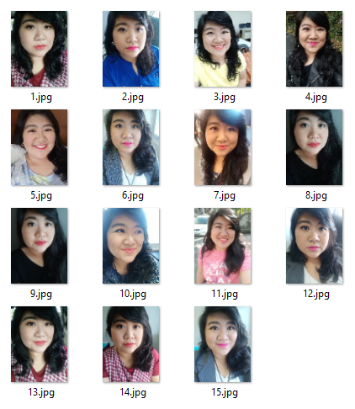
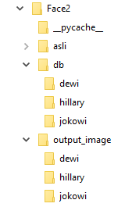
Prepare The Image 1
db/dewi

Slide 3
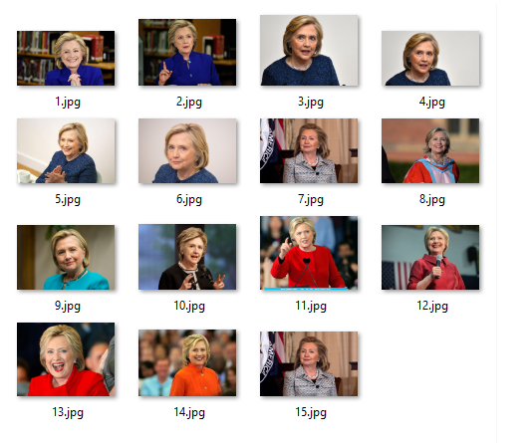
Prepare The Image 2
db/hillary

Slide 4
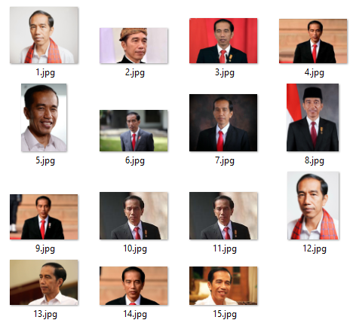
Prepare The Image 3
db/jokowi

Slide 5
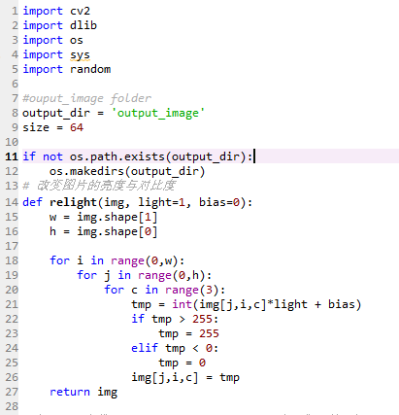
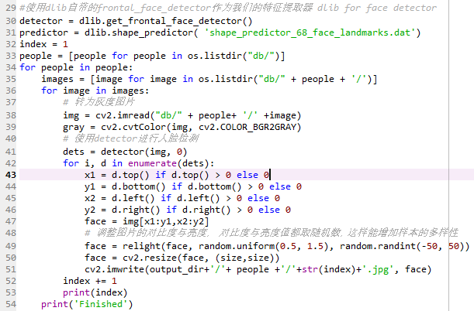
Prepare the output image using dlib, opencv

Slide 6
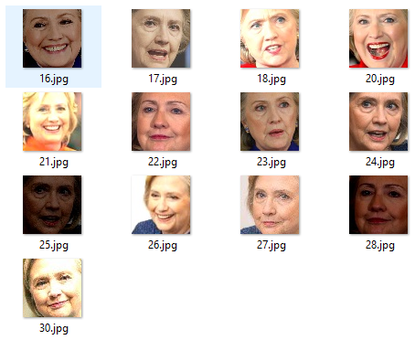
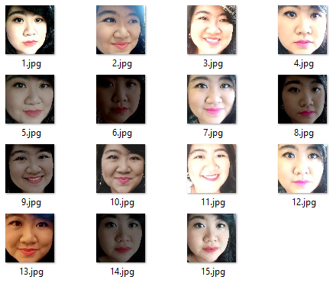
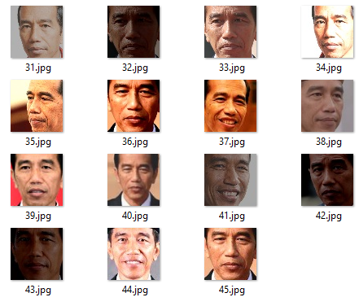
Output_image
2
1
3

Slide 7
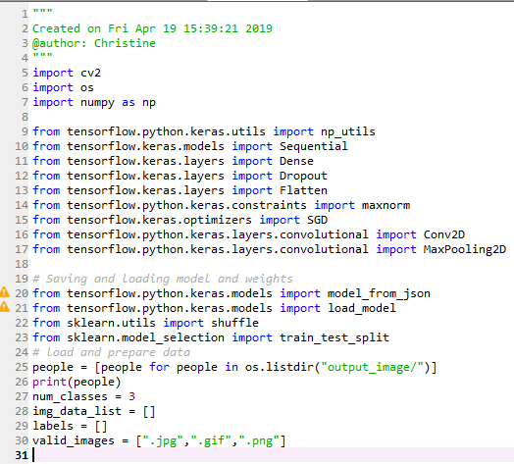
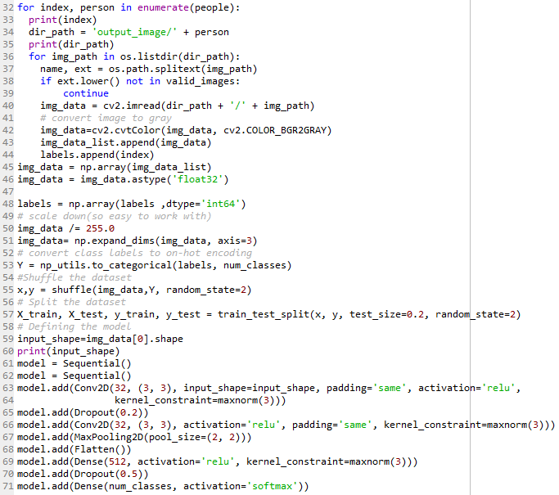
Train the weight & Model from output_image) = using tensorflow, keras

Slide 8
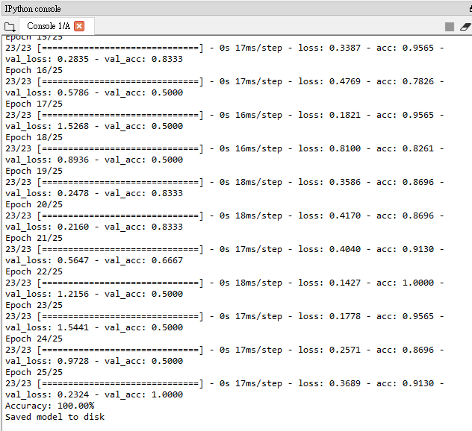
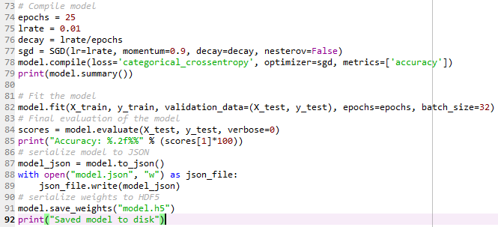
Train the weight & Model from output_image)

Slide 9
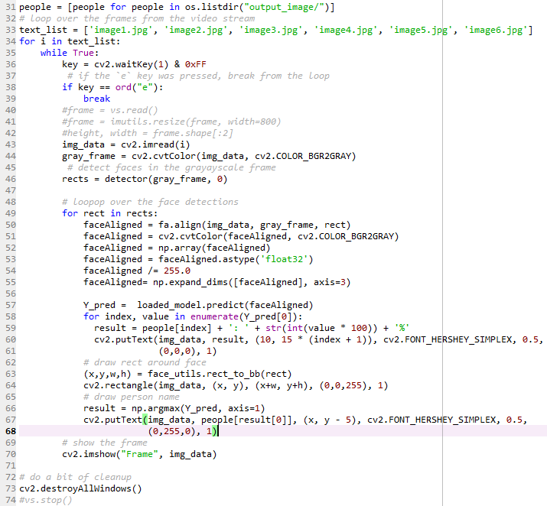
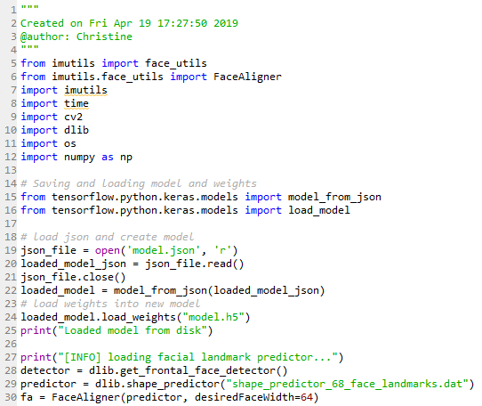
Prepare for testing

Slide 10
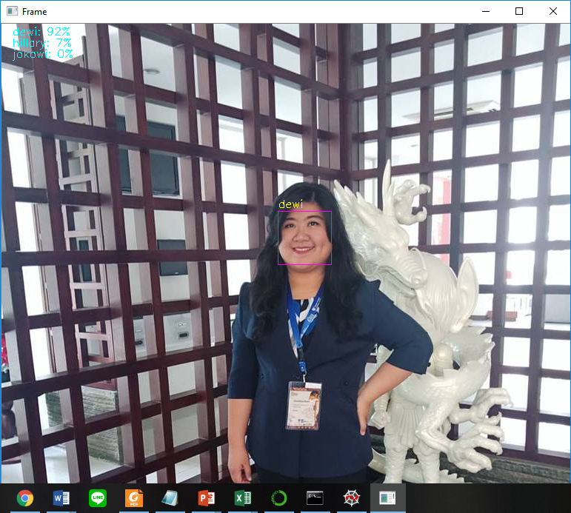
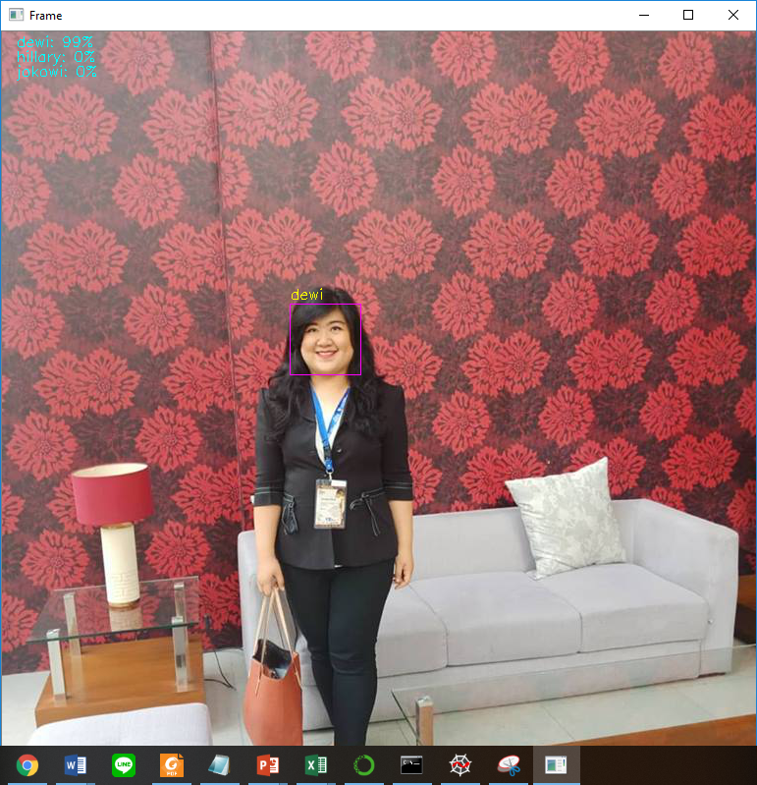
RESULT dewi
Dewi : 92%
Hillary : 7%
Jokowi : 0%
Dewi : 99%
Hillary : 0%
Jokowi : 0%

Slide 11
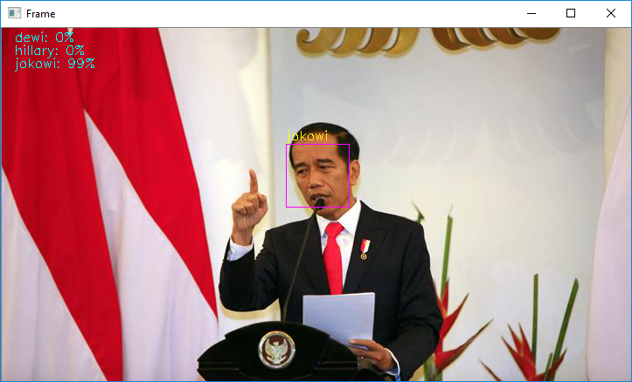
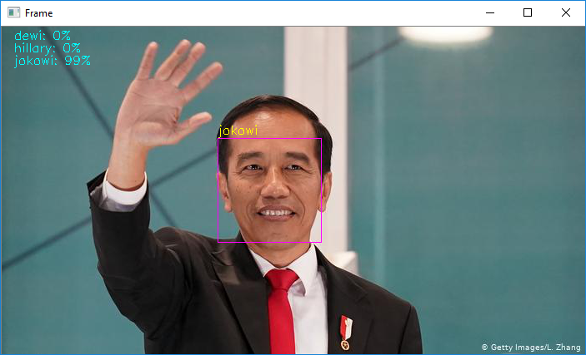
Result jokowi
Dewi : 0%
Hillary : 0%
Jokowi : 99%
Dewi : 0%
Hillary : 0%
Jokowi : 99%

Slide 12
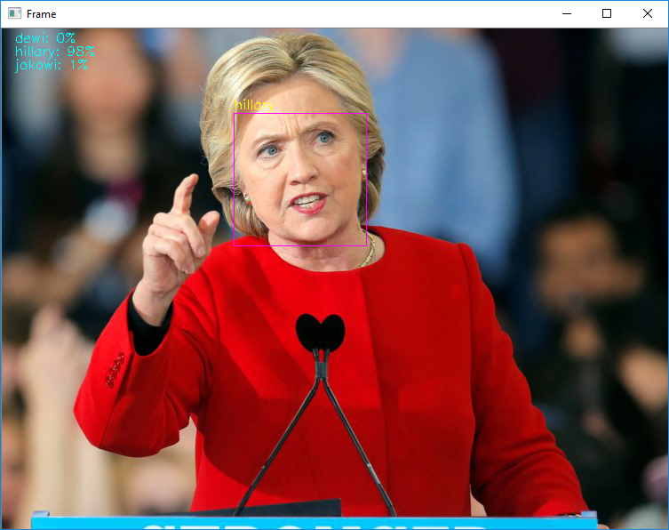
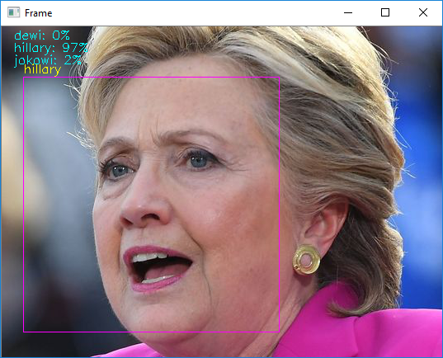
Result hillary
Dewi : 0%
Hillary : 98%
Jokowi : 1%
Dewi : 0%
Hillary : 97%
Jokowi : 2%

Slide 13

☺ Thank you ☺
Christine Dewi, S.Kom., M.Cs.
E-mail :
christine.dewi13@gmail.com
christine.dewi@uksw.edu,
s10714904@cyut.edu.tw
Department of Information Management,
Chaoyang University of Technology
168, Jifong East Road, Wufong Dist., Taichung City 41349, Taiwan (R.O.C.)
Department of Information Technology
Satya Wacana Christian University
JL. Diponegoro 52 – 60, Salatiga 50711Central Java, Indonesia.

